Slide 1
Lecture 3 Project Organization and Defining
Contents
Project Organization: Structure and Culture
Defining the Project

Slide 2
Project Organization: Structure and Culture
What are Project Management Structures?
What is the Right Project Management Structure?
What is Organizational Culture?
What are Implications of Organizational Culture for Organizing Projects?
How to identify cultural characteristics?

Slide 3
Project management structures
Organizing Projects within the Functional Organization
Organizing Projects as Dedicated Teams
Organizing projects within Matrix Arrangement

Slide 4
Organizing Projects within the Functional Organization
Different segments of the project are delegated to respective functional units.
Coordination is maintained through normal management channels.
Used when the interest of one functional area dominates the project or one functional area has a dominant interest in the project’s success.

Slide 5
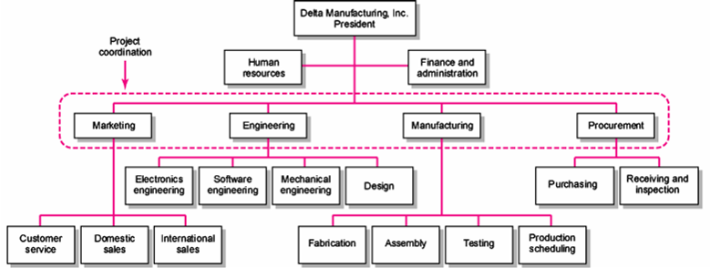
Organizing Projects within the Functional Organization

Slide 6
Organizing Projects within the Functional Organization
Advantages
- No Structural Change
- Flexibility
- In-Depth Expertise
- Easy Post-Project Transition
Disadvantages
- Lack of Focus
- Poor Integration
- Slow
- Lack of Ownership

Slide 7
Organizing Projects as Dedicated Teams
Teams operate as separate units under the leadership of a full-time project manager.
In a projectized organization where projects are the dominant form of business, functional departments are responsible for providing support for its teams.

Slide 8
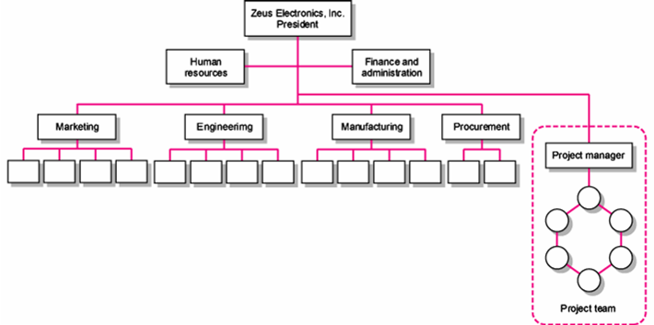
Organizing Projects as Dedicated Teams

Slide 9
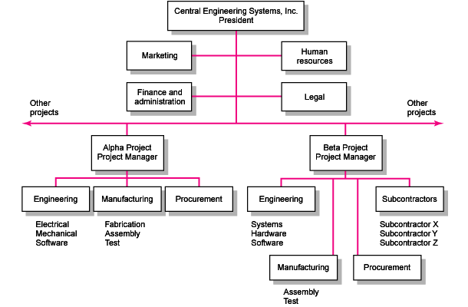
Organizing Projects as Dedicated Teams
Project Organizational Structure

Slide 10
Organizing Projects as Dedicated Teams
Advantages
- Simple
- Fast
- Cohesive
- Cross-Functional Integration
Disadvantages
- Expensive
- Internal Strife
- Limited Technological Expertise
- Difficult Post-Project Transition

Slide 11
Organizing projects within Matrix Arrangement
Hybrid organizational structure (matrix) is overlaid on the normal functional structure.
- Two chains of command (functional and project)
Project participants report simultaneously to both functional and project managers.
Matrix structure optimizes the use of resources.
Allows for participation on multiple projects while performing normal
functional duties
- Achieves a greater integration of expertise and project requirements

Slide 12
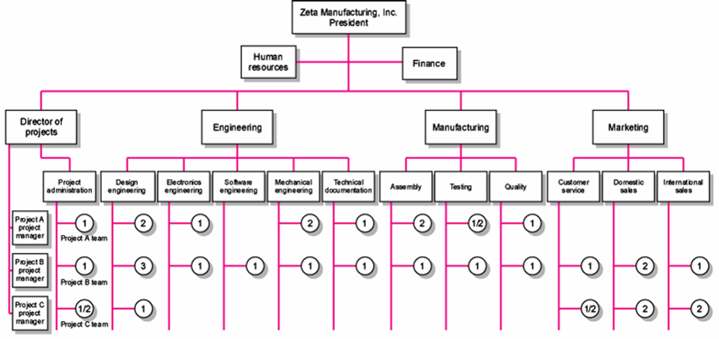
Organizing projects within Matrix Arrangement

Slide 13
Organizing projects within Matrix Arrangement
Different Matrix Forms
Functional (also Weak or Lightweight) Form
Matrices in which the authority of the functional manager predominates and the project manager has indirect authority
Balance (or Middleweight) Form
The traditional matrix form in which the project manager sets the overall plan and the functional manager determines how work to be done
Strong (Heavyweight) Form
Resembles a project team in which the project manager has broader control and functional departments act as subcontractors to the project

Slide 14
Organizing projects within Matrix Arrangement
Advantages
- Efficient
- Strong Project Focus
- Easier Post-Project Transition
- Flexible
Disadvantages
- Dysfunctional Conflict
- Infighting
- Stressful
- Slow

Slide 15
What is the Right Project management structure
Organization (Form) Considerations
- How important is the project to the firm’s success?
- What percentage of core work involves projects?
- What level of resources (human and physical) are available?

Slide 16
What is the Right Project management structure
Project Considerations
- Size of project
- Strategic importance
- Novelty and need for innovation
- Need for integration (number of departments involved)
- Environmental complexity (number of external interfaces)
- Budget and time constraints
- Stability of resource requirements

Slide 17
Organizational Culture
What is Organizational Culture?
A system of shared norms, beliefs, values, and assumptions which bind people together, thereby creating shared meanings
The “personality” of the organization that sets it apart from other organizations.
- Provides a sense of identity to its members
- Helps legitimize the management system of the organization
- Clarifies and reinforces standards of behavior

Slide 18
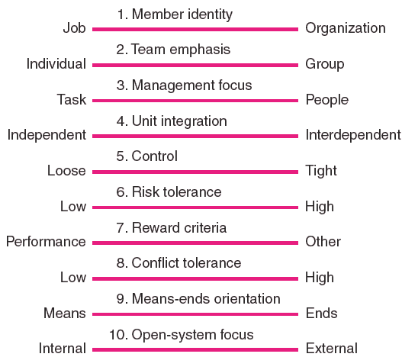
Organizational Culture
What are Key Dimensions Defining an Organization’s Culture?

Slide 19
Organizational Culture
How to Identify Cultural Characteristics
Study the physical characteristics of an organization.
Read about the organization.
Observe how people interact within the organization.
Interpret stories surrounding the organization

Slide 20
Defining the Project
What is defining the project?
5 steps of defining the project
Process Breakdown structure
Responsibility matrices
Project communication plan

Slide 21
What is defining the project
Defining project is the process by which the deliverables and work to produce them are identified and defined

Slide 22
5 Steps of defining the project
Step 1: Defining the Project Scope
Step 2: Establishing Project Priorities
Step 3: Creating the Work Breakdown Structure
Step 4: Integrating the WBS with the Organization
Step 5: Coding the WBS for the Information System

Slide 23
Step 1: Defining the Project Scope
Project Scope
- A definition of the end results or mission of the project—a product or service for the client/customer—in specific, tangible, and measurable terms.
Purpose of the Scope Statement
- To clearly define the deliverable(s) for the end user.
- To focus the project on successful completion of its goals.
- To be used by the project owner and participants as a planning tool and for
measuring project success.

Slide 24
Step 1: Defining the Project Scope
Project Scope Checklist
Project objective
Deliverables
Milestones
Technical requirements
Limits and exclusions
- Reviews with customer

Slide 25
Step 1: Defining the Project Scope
Scope Statements
Also called statements of work (SOW)
Project Charter
- Can contain an expanded version of scope statement
A document authorizing the project manager to initiate and lead the project.
Scope Creep
- The tendency for the project scope to expand over time due to changing
requirements, specifications, and priorities.

Slide 26
Step 2: Establishing Project Priorities
Causes of Project Trade-offs
- Shifts in the relative importance of criterions related to cost, time, and
performance parameters
+ Budget–Cost
+ Schedule–Time
+ Performance–Scope
Managing the Priorities of Project Trade-offs
- Constrain: a parameter is a fixed requirement.
- Enhance: optimizing a parameter over others.
- Accept: reducing (or not meeting) a parameter requirement.
Scope
Quality
Time
Cost

Slide 27
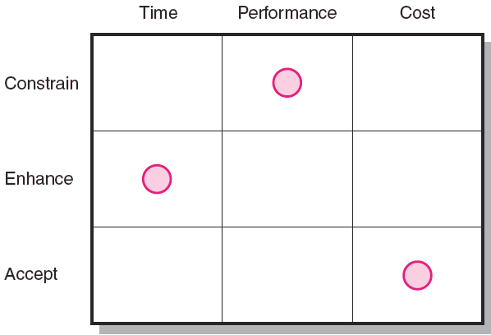
Step 2: Establishing Project Priorities
Project Priority Matrix

Slide 28
Step 3: Creating the Work Breakdown Structure
Work Breakdown Structure (WBS)
An hierarchical outline (map) that identifies the products and work elements involved in a project
- Defines the relationship of the final deliverable (the project) to its
sub-deliverables, and in turn, their relationships to work packages
- Best suited for design and build projects that have tangible outcomes rather
than process-oriented projects

Slide 29
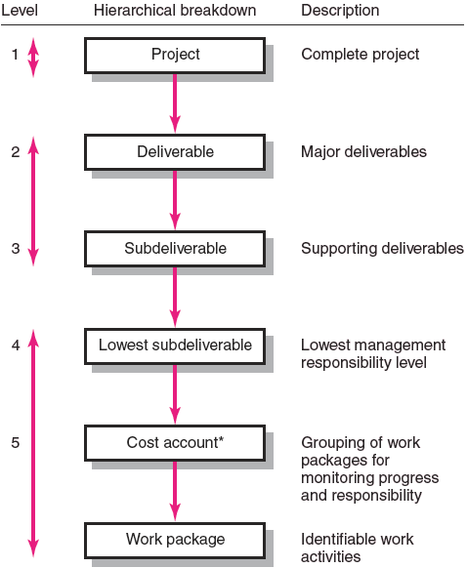
Step 3: Creating the Work Breakdown Structure
Hierarchical Breakdown of the WBS

Slide 30
Step 3: Creating the Work Breakdown Structure
How WBS Helps the Project Manager
- Facilitates evaluation of cost, time, and technical performance of the
organization on a project
- Helps in the development of the organization breakdown structure (OBS),
which assigns project responsibilities to organizational units and individuals
- Provides management with information appropriate to each organizational
level
Helps manage plan, schedule, and budget
- Defines communication channels and assists in coordinating the various
project elements

Slide 31
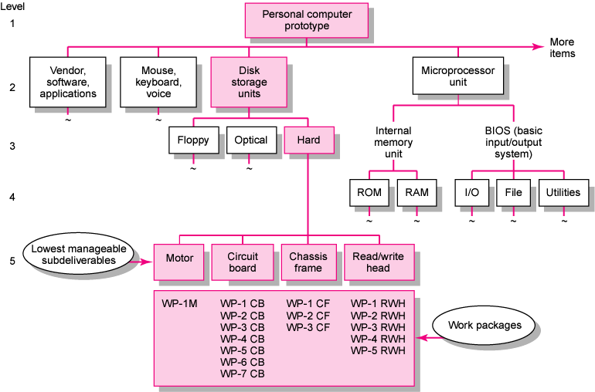
Step 3: Creating the Work Breakdown Structure
Work Breakdown Structure

Slide 32
Step 3: Creating the Work Breakdown Structure
A Work Package Is the Lowest Level of the WBS: It is output-oriented in that it:
Defines work (what)
Identifies time to complete a work package (how long)
Identifies a time-phased budget to complete a work package (cost)
Identifies resources needed to complete a work package (how much)
- Identifies a single person responsible for units of work (who)

Slide 33
Step 4: Integrating the WBS with the Organization
Organizational Breakdown Structure (OBS): Depicts how the firm is organized to discharge its work responsibility for a project
Provides a framework to summarize organization work unit performance
Identifies organization units responsible for work packages
- Ties the organizational units to cost control accounts

Slide 34
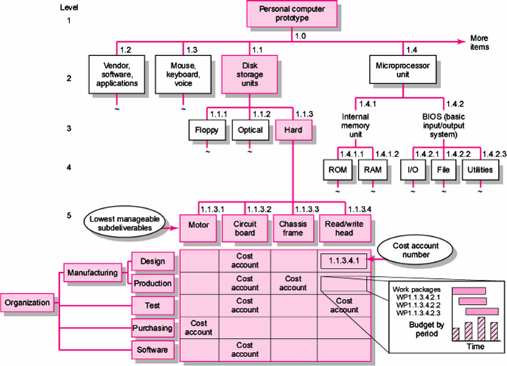
Step 4: Integrating the WBS with the Organization
Integration of WBS and OBS

Slide 35
Step 5: Coding the WBS for the Information System
WBS Coding System
- Defines:
+ Levels and elements of the WBS
+ Organization elements
+ Work packages
+ Budget and cost information
- Allows reports to be consolidated at any level in the organization structure

Slide 36
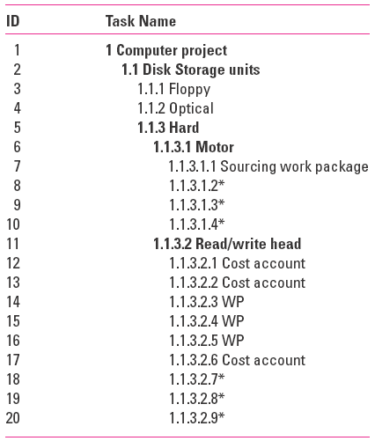
Step 5: Coding the WBS for the Information System
WBS Coding

Slide 37
Process Breakdown Structure
Process-Oriented Projects
- Are driven by performance requirements in which the final outcome is the
product of a series of steps of phases in which one phase affects the next
phase
Process Breakdown Structure (PBS)
- Defines deliverables as outputs required to move to the next phase
- Checklists for managing PBS:
+ Deliverables needed to exit one phase and begin the next
+ Quality checkpoints for complete and accurate deliverables
+ Sign-offs by responsible stakeholders to monitor progress

Slide 38
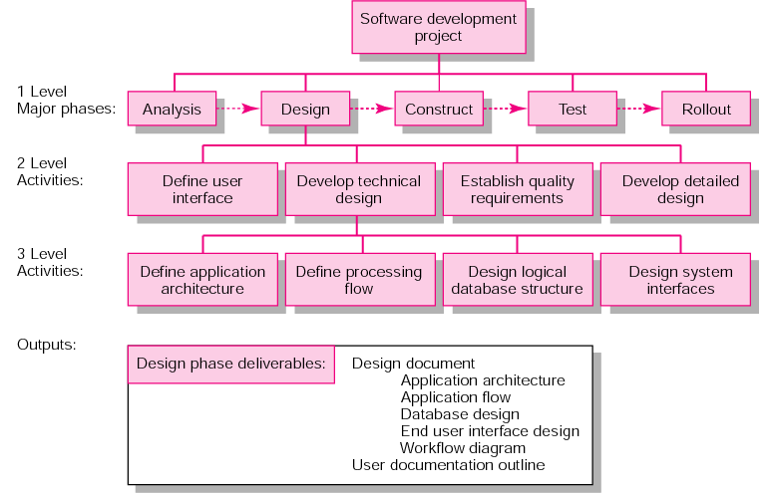
Process Breakdown Structure
Example of PBS for Software Project Development

Slide 39
Responsibility Matrices
Summarizes the tasks to be accomplished and who is responsible for what on the project
Lists project activities and participants
- Clarifies critical interfaces between units and individuals that need
coordination
- Provide a mean for all participants to view their responsibilities and agree
on their assignments
- Clarifies the extent or type of authority that can be exercised by each
participant

Slide 40
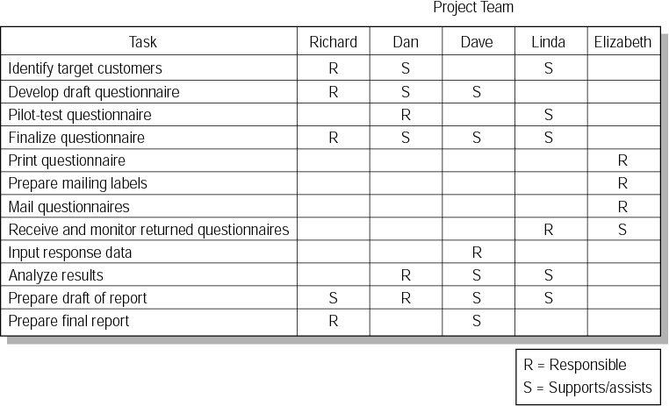
Responsibility Matrices
Example of Responsibility Matrix for a Market Research Project

Slide 41
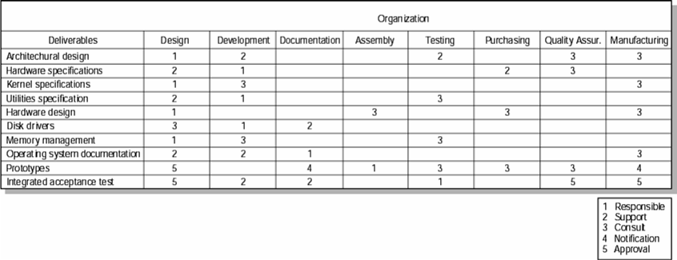
Responsibility Matrices
Example of Responsibility Matrix for the Conveyor Belt Project

Slide 42
Project Communication Plan
What information needs to be collected?
Who will receive information?
What information methods will be used?
What are the access restrictions?
When will information be communicated?
How will information be communicated?

Slide 43
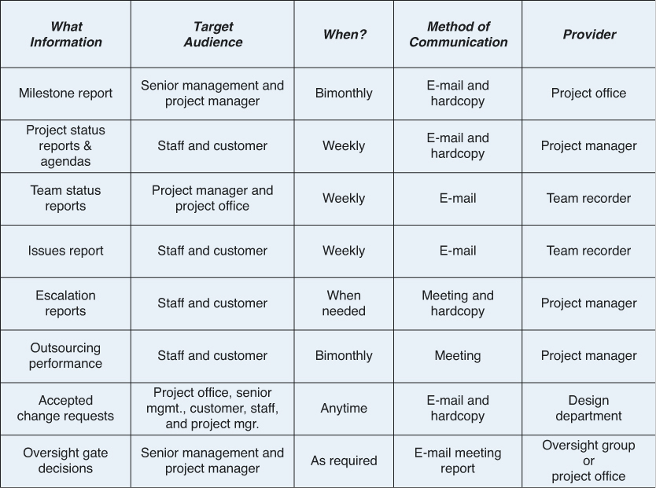
Project Communication Plan

